Slide 1
Java Native Interface (JNI)

Slide 2
Java Native Interface
Java Native Interface (JNI) is used to support native code
    native code -->Non java code
JNI is like an bridge between the bytecode running in JVM and native code.
Method Definition
Java_”PackageName”_”ClassName”_”MethodName”

Slide 3
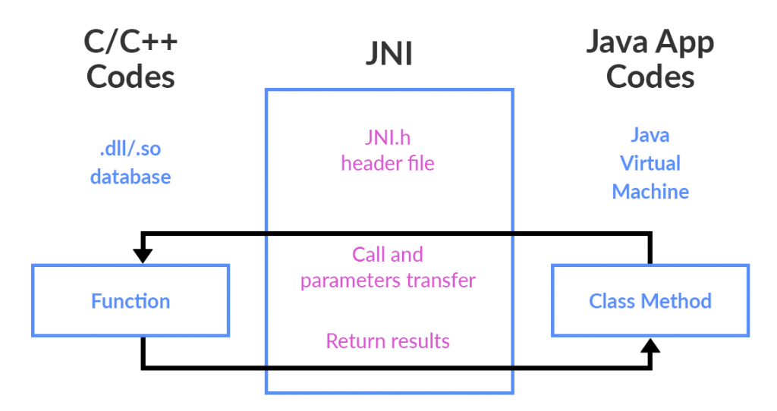
Component Needed for JNI Application
1.Java Code
2.Native code
3.JNI header file
4.C/C++ compiler

Slide 4
Components Needed
Java Code – our classes. They will include at least one native method.
Native Code – the actual logic of our native methods, usually coded in C or C++.
JNI header file – this header file for C/C++ (include/jni.h into the JDK directory) includes all definitions of JNI elements that we may use into our native programs.
C/C++ Compiler – we can choose between GCC, Clang, Visual Studio, or any other we like as far as it's able to generate a native shared library for our platform.

Slide 5
JNI Elements
There are two elements
1.Java Elements
2.C/C++ Elements
Java elements:
“native” keyword – as we've already covered, any method marked as native must be implemented in a native, shared lib.
System.loadLibrary(String libname) – a static method that loads a shared library from the file system into memory and makes its exported functions available for our Java code.

Slide 6
JNI Element
C/C++ elements (many of them defined within jni.h)
JNIEXPORT- marks the function into the shared lib as exportable so it will be included in the function table, and thus JNI can find it
JNICALL – combined with JNIEXPORT, it ensures that our methods are available for the JNI framework
JNIEnv – a structure containing methods that we can use our native code to access Java elements
JavaVM – a structure that lets us manipulate a running JVM (or even start a new one) adding threads to it, destroying it, etc…

Slide 7
Loading Native Libraries
Native code is usually compiled into a shared library and loaded before that native methods can be called.
static {
System.loadLibrary("mylibrary");
}
Another method is java.library.path directorie
System.load("/path/to/mylibrary.so");

Slide 8
Register Native code
1.Write the native method implementation in C or C++ code:
#include <jni.h>
JNIEXPORT jstring JNICALL
Java_com_example_MyClass_myNativeMethod(JNIEnv *env, jobject obj) {
// Implementation code here
return (*env)->NewStringUTF(env, "Hello from native code!");
}
2.Compile the C or C++ code into a shared library:
3.Load the shared library into the Java program:
System.loadLibrary("mynative");
4.Declare the native method in the Java code:
public native String myNativeMethod();
5.Call the native method from the Java code:
MyNativeMethod();

Slide 9
JNI Overloading
The Overloading Method can be native or regular method.
Its a Unique signature in C++.
Overloading native with different parameters
1.Different parameter passing.
Public native double add(double x);
Public native double add(double x,double y);
2.Non native methods.
Public native double add(double x); // Native Method
Public double add(double x) // Non Native Method
{
return x;
}

Slide 10
JNI Overloading
Java_”packageName”_”ClassName”_”MethodName”_ _ “Method parameter signature”

Slide 11
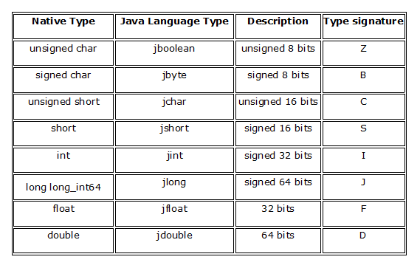
JNI Primitive Types
An overview of primitive types mapping from java to C/C++
Signature of different types

Slide 12
JNI Primitive types
Public class ClassName{
public native boolean function(boolean param);
// Java_PackageName_ClassName_MethodName_ _Z(JNIEnv *,Jobject ,Jboolean );
Z-->Boolean signature
public native boolean function(boolean param);
// Java_PackageName_ClassName_MethodName_ _Z(JNIEnv *,Jobject ,Jboolean );
public native void function();
// Java_PackageName_ClassName_MethodName_ _(JNIEnv *,Jobject );
Void --> nothing
public native void function(short param);
// Java_PackageName_ClassName_MethodName_ _S(JNIEnv *,Jobject ,Jshort );
S-->Short signature
public native void function(double param);
/// Java_PackageName_ClassName_MethodName_ _D(JNIEnv *,Jobject ,Jdouble );
D-->Double signature
public native int function(int param,double param1,short param2,char param3,long int param4);
/// Java_PackageName_ClassName_MethodName_ _IDSCJ(JNIEnv *,Jobject ,Jint ,Jdouble, Jshort, Jchar, Jlong int );
}

Slide 13
JNI Working with primitive Arrays
Primitive : double -> jdouble ,float -> jfloat ,
int -> jint(signed)
Primitive Array : double[] -> jdoubleArray ,float[] -> jfloatArray ,int[] -> jintArray
All these types are subtypes of jobjects

Slide 14
JNI Working with Primitive Array
Step 1: Create a new Java array
JdoubleArray jarray = env->new DoubleArray(len);
Step 2: Create the C++ array and fill it with the value
Jdouble carray[] = {1,2,3,4,5};
Step 3: To Copy the value from C++Array to Java array
env->SetDoubleArrayRegion(jarray, 0 ,5 ,carray);
To Copy the value from Java array to C++Array
env->GetDoubleArrayRegion(jarray, 0, 5, carray);
Jarray -> java array, 0 -> Array start index, 5->lenght of the array, carray -> C++ array

Slide 15
JNI Working with Primitive array
(Java file code)
private ActivityMainBinding binding;
@Override
protected void onCreate(Bundle savedInstanceState) {
super.onCreate(savedInstanceState);
binding = ActivityMainBinding.inflate(getLayoutInflater());
setContentView(binding.getRoot());
// Example of a call to a native method
TextView tv = binding.sampleText;
tv.setText(stringFromJNI());
int[] intarray = setarray(0,5,5);
String numberString = TextUtils.join(", ", Arrays.asList(Arrays.toString(intarray))); //Int array to string converting
tv.setText("C++ to Java ----> "+numberString);
TextView tv1 = binding.textView;
int intvalue = getarray(intarray);
tv1.setText("Sum of the Array ---> "+String.valueOf(intvalue));
}
private native int[] setarray(int start,int end ,int num);
private native int getarray(int[] array);
public native String stringFromJNI();

Slide 16
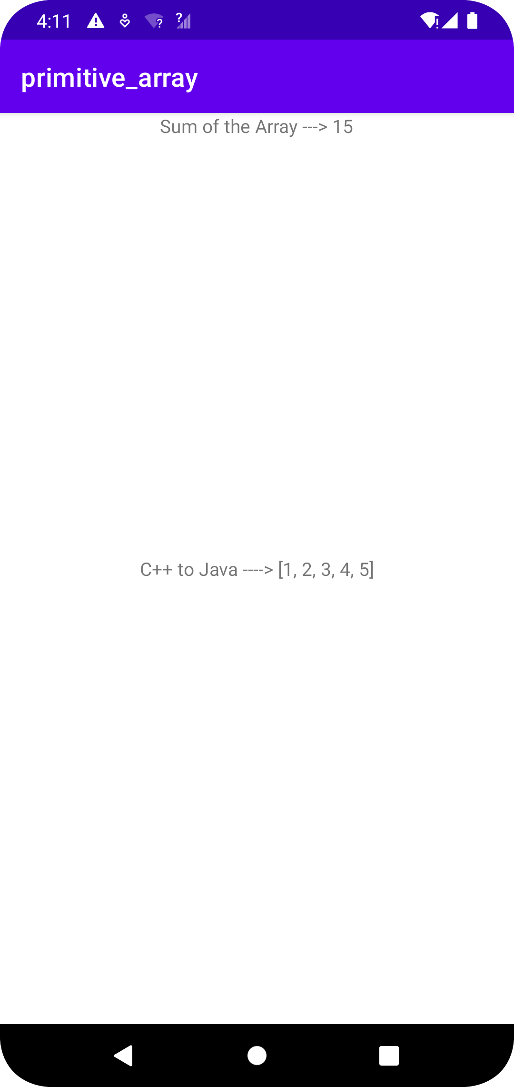
JNI Working with Primitive array
(Native C++ file code)
extern "C" JNIEXPORT jintArray JNICALL Java_com_example_myapplication_MainActivity_setarray(JNIEnv *env,jobject,jint start,jint end,jint num)
{
//Step 1: Create a new jintArray java Array
jintArray jarray = env->NewIntArray(num);
//Step 2: Create a new c++ array
jint array[] = {1,2,3,4,5};
//Step 3: To copy the value from C++ to Java array
env->SetIntArrayRegion(jarray,start,end,array);
return jarray;
}
extern "C"
JNIEXPORT jint JNICALL
Java_com_example_myapplication_MainActivity_getarray(JNIEnv *env, jobject , jintArray array) {
//Step 1: Lenght of the java array
jint len = env->GetArrayLength(array);
jint sum = 0;
//Step 2: Create a new c++ array
jint carray[5];
//step 3: To copy the value from Java array to C++ array
env->GetIntArrayRegion(array,0,len,carray);
for(jint i =0;i<len;i++)
{
sum = sum + carray[i];
}
return sum;
}

